Slide 1
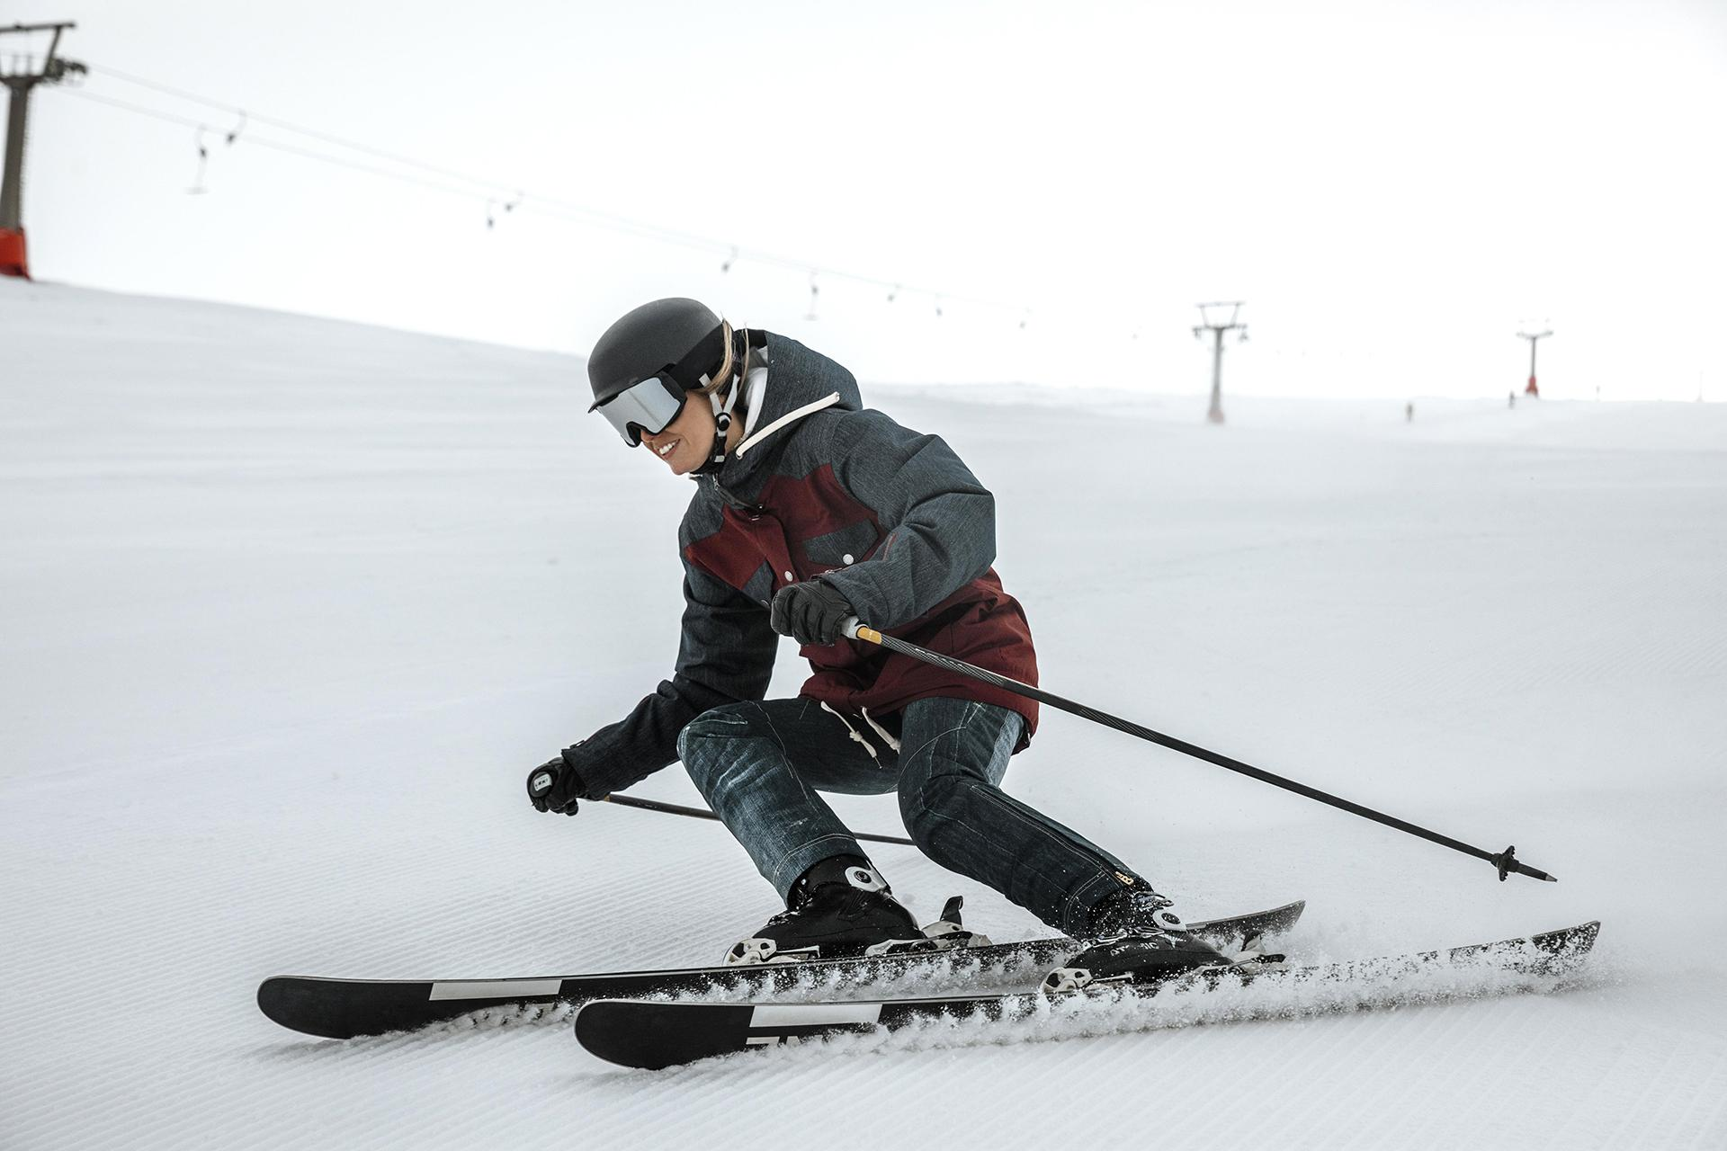
Big Mountain Resort:
Using Models to Reimagine Resort Ticket Pricing
Edwin Ng
// Slidesgo Snow

Slide 2
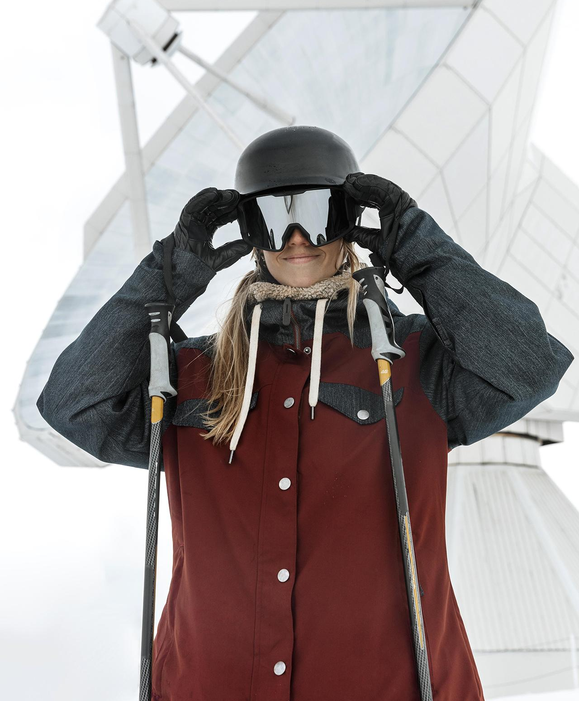
Big Mountain
Resort
Big Mountain Resort is a ski resort located in Montana that boasts 105 trails and hosts about 350,000 skiers and snowboarders each year.
The resort recently invested $1.54 million dollars to install a new chair lift.
Resort management feels as though the resort is not capitalizing on their facilities as much as they could be.
Previous ticket pricing strategies were simply based on charging above average prices across resorts.

Slide 3
How Can We Do This?
How can Big Mountain Ski Resort adjust its ticket pricing based on facility composition relative to other ski resorts such that they can recover the $1.54 million investment cost in revenue over a span of 3 years while still remaining competitive in their pricing?

Slide 4
Recommendations
Raise Ticket Price
Increase Vertical Drop
Close Down 5 Runs
1
2
3
The resorts facilities can support a higher price - bringing in higher revenue.
Creating a new run and installing an additional chair lift would support further ticket price increases.
Closing down 5 of our most unpopular runs would help reduce maintenance costs and save us money.

Slide 5
Modeling Results & Analysis
A breakdown of various scenarios we modelled.

Slide 6
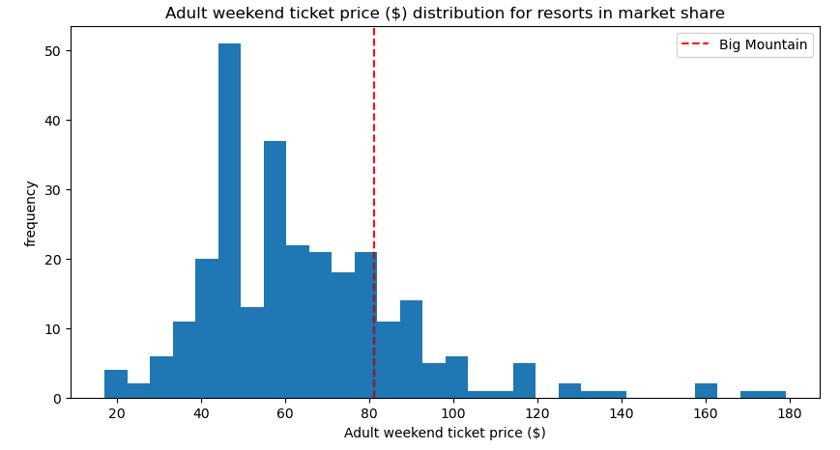
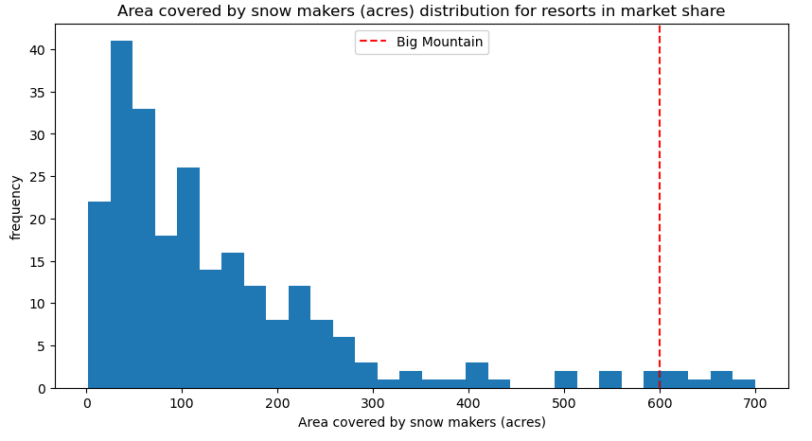
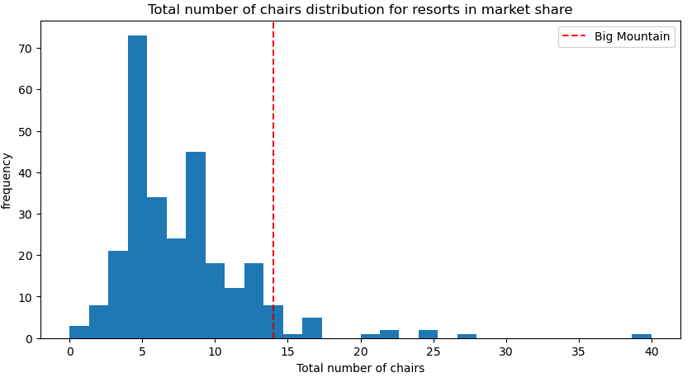
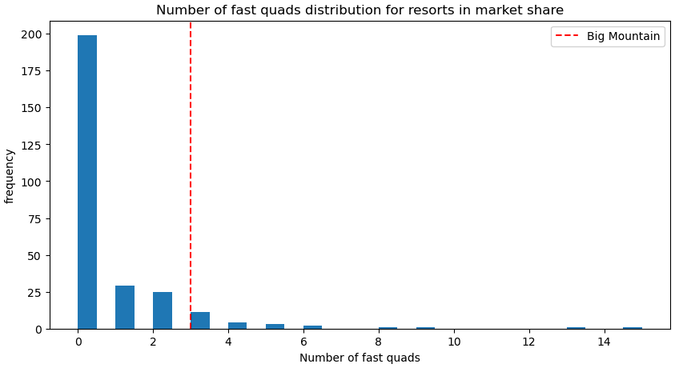
Increasing Ticket Price
Our current Adult Weekend ticket price is $81.00
Big Mountain Resort ranks particularly high in some of the most desirable features a ski resort can have.
Our models predict that we can raise Adult Weekend ticket prices up to $95.87!

Slide 7
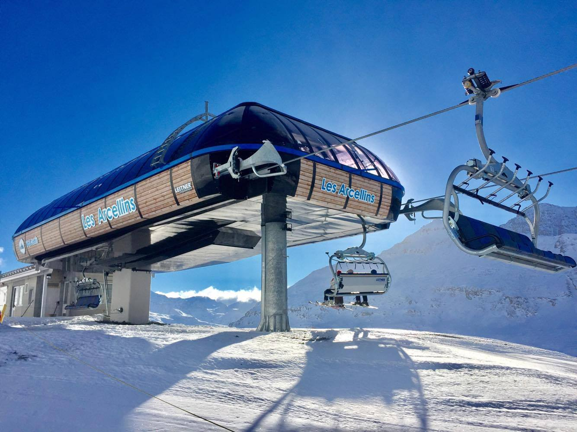
Increasing Vertical Drop
This scenario involves creating a new run and installing yet another chairlift.
Over the season this would lead to an increase in revenue of $15,065,471.
This would increase the overall vertical drop of the resort by 150 feet and allow for a better distribution of guests around the resort.
Our models predict that we can raise Adult Weekend ticket by $8.61

Slide 8
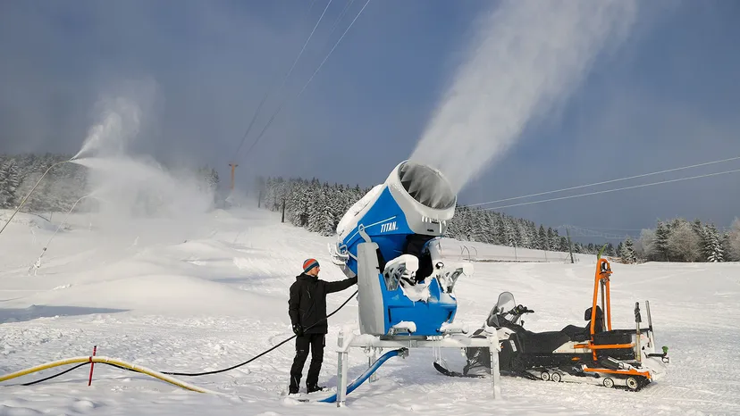
Increasing Vertical Drop & Snow Cover
NOTE: this scenario is in addition to the previous (installing a new chairlift and new run)
Compared to the previous scenario, the impact is minimal. This change only raises the price by an additional $1.29
In this scenario, we add an additional 2 acres of snow coverage.
Our models predict that we can raise Adult Weekend ticket prices by $9.90

Slide 9
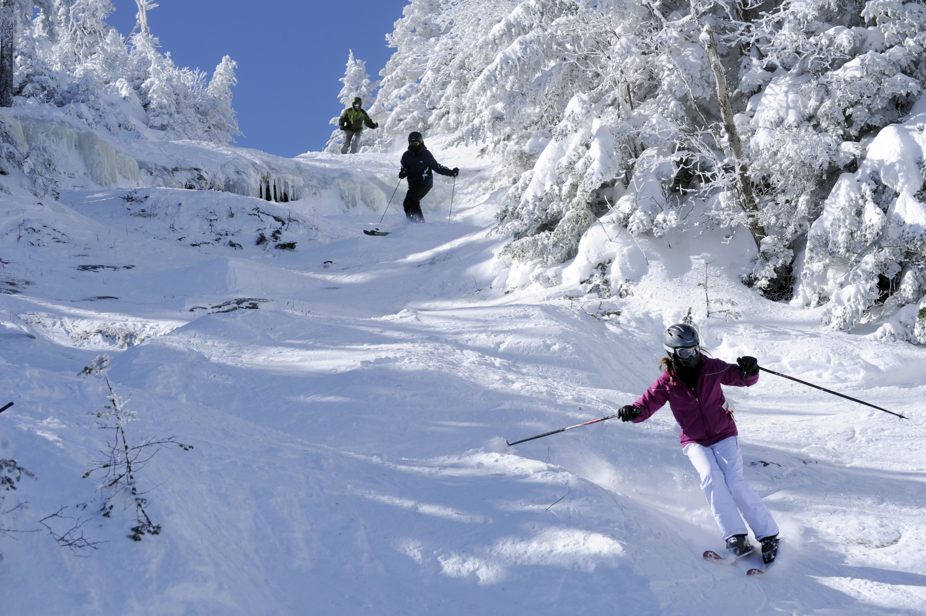
Increasing Run Length & Snow Cover
In this scenario, we increase the length of our longest run by 0.2 miles and add 4 acres of snow coverage.
Our models predict that there will be no difference in adult weekend price.
This is because our model marks longest run as an unimportant feature when it comes to adult weekend ticket pricing.

Slide 10
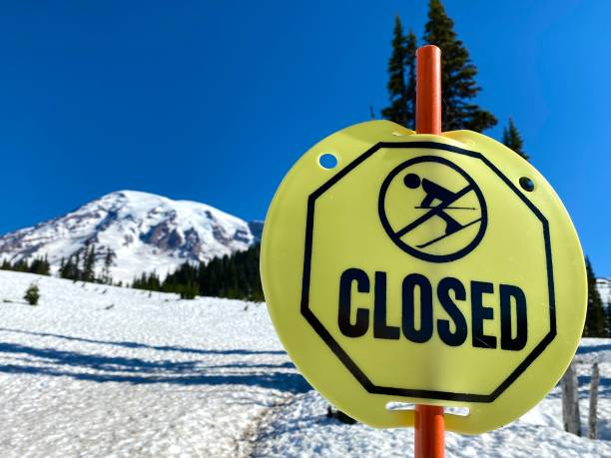
Closing Up to 10 Runs
In this scenario, we model the change in ticket price and revenue as we close down up to 10 runs.
Our models predict that any number of closed runs will decrease ticket price.
Closing down 5 runs seems to be the optimal balance between lowering ticket prices and increasing revenue via operation cost reduction.
Closing down 2 and 3 runs down lowers ticket price.
Closing down 3 runs is the same as closing 4 or 5 runs.
Closing down more than 5 runs leads to a large drop in ticket price.

Slide 11
Increasing Ticket Price
Our current Adult Weekend ticket price is $81.00
Big Mountain Resort ranks particularly high in some of the most desirable features a ski resort can have.
Our models predict that we can raise Adult Weekend ticket prices up to $95.87!

Slide 12
Conclusions
Here are the following combination of actions I would recommend:
Increase Adult Weekend ticket price by a minimum of $5 up to a per-ticket price of $95.87
Increase the resort’s vertical drop by 150 feet by creating a new run
Install an additional chair lift to help disburse guests throughout the resort - increasing access to facilities.
Close down 5 of the most unpopular runs to reduce operational costs.

Slide 13
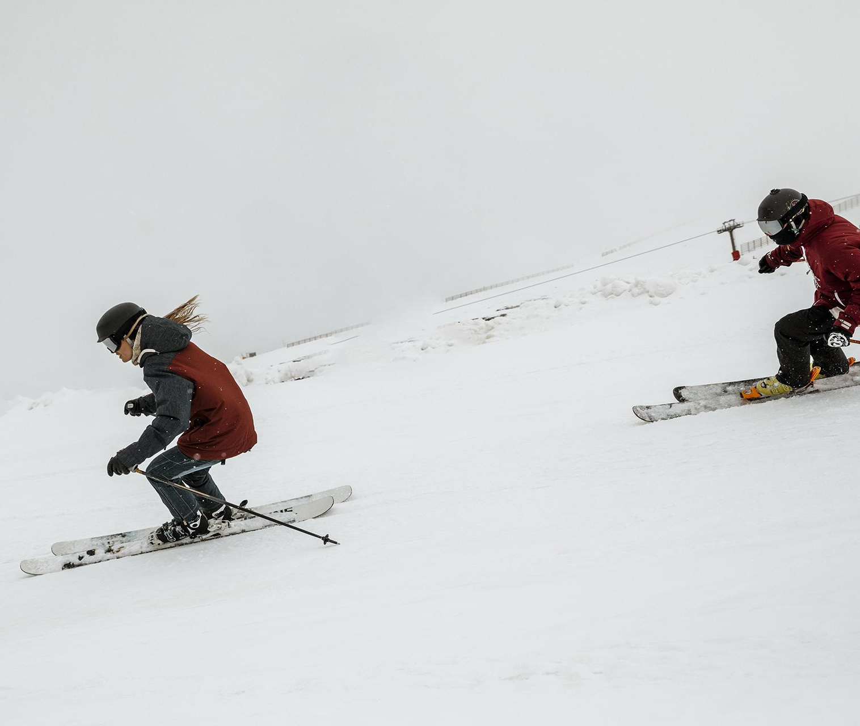
Thank
You!
Do you have any questions?
ngchitsung@gmail.com
(+1) 425 - 281 - 3040
https://www.linkedin.com/in/edwin-ng21/
Please keep this slide for attribution

